Slide 1

Become a Data Nerd with low code
ML.Net - Model Builder
Azure Cognitive Services
Microsoft Power BI

Slide 2


Dinesh Kumar P
Product Manager,
Reports & Analytics Squad,

Slide 3
Agenda
Machine Learning in layman’s term.
Evolution of No code/ Low code platforms.
Workshop with Azure Cognitive Text Analytics, ML.Net Model Builder.

Slide 4
What is Machine Learning ?
Looking for patterns in prepared data that we have already.
Generate Code based on algorithm.
Recognize those pattern in new data. (whichever is trained)

Slide 5
What Machine Learning does?
Predict Future.
Organize.
Group.
Simple examples like GMAIL is a best example:
-> Spam or not-Spam – Binary Text classification.
-> k-means clustering.

Slide 6
Features vs Labels
Features
Input
Labels
Output
Name, Amount, Where Issued, Age of Cardholder
Genuine/Fraud

Slide 7
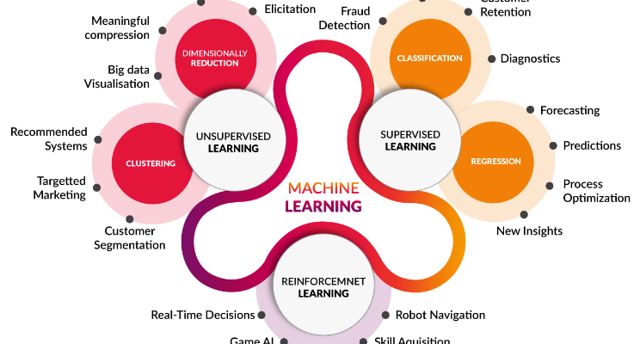
Algorithm - Types

Slide 8
Five Questions to cover algorithms
1. Is this A or B ?
2. Is this Weird ?
3. How much effective or many ?
4. How this should be organized ?
5. What should I do next ?
Notes:
Classification.
Anomaly Detection.
Regression.
Clustering.
Reinforcement.

Slide 9
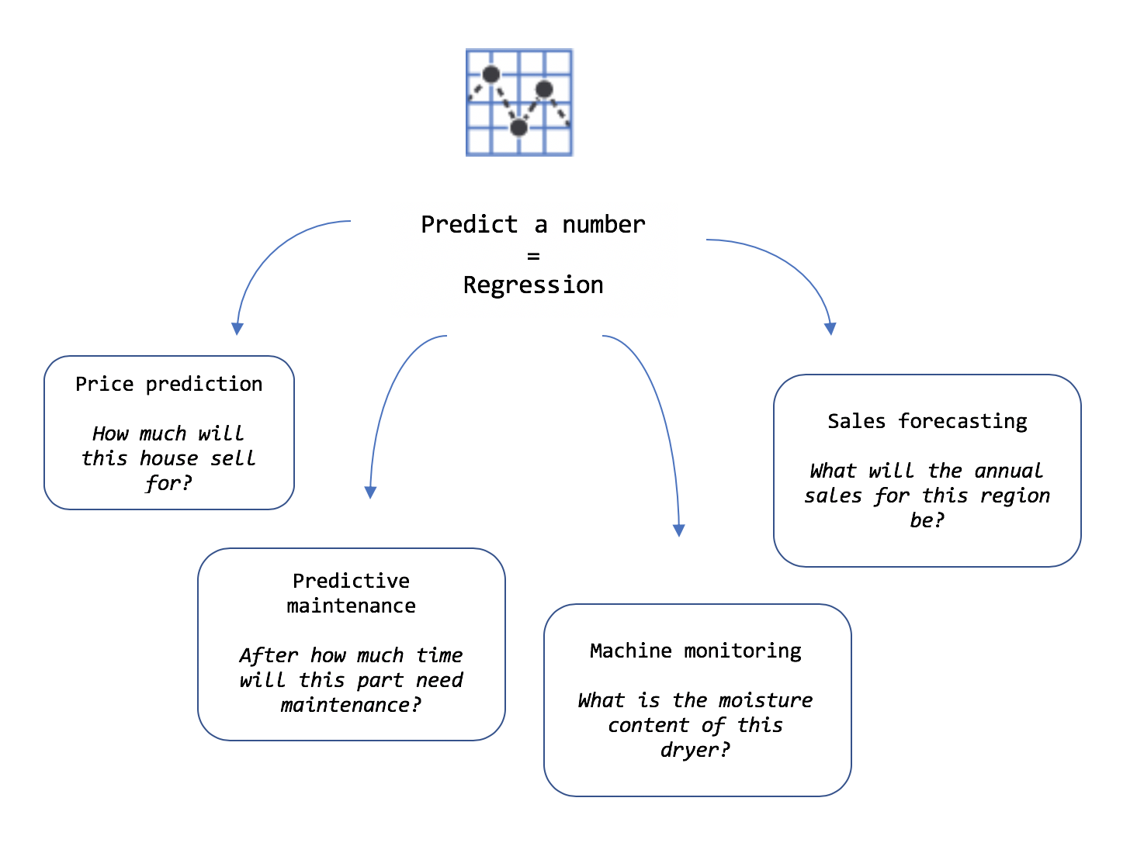
Clear about the requirement

Slide 10
Role of a Data Scientist
Data to use? Is there trained data already available?
How should that data be processed to create prepared data?
Identify Combinations of prepared data and machine learning algorithms should you use to create the best model?

Slide 11
ML.Net
Open source cross-platform machine learning framework.
Auto ML made easy to play via Model Builder with GUI.
Not required much expertise in ML.

Slide 12
If you know the problem well, figuring solution is as simple as it is.
Defining problem is 80%
Solution is just 20%

Slide 13
No/Low Code dev platforms
Problems better solvable by industry / business people like citizen data scientist.
DIY – Do It Yourself mindset.
Microsoft PowerApps - overall combined feature set for analytics end-to-end.
Adobe Photoshop vs Canva.
Notes:
I hope you know tools like Canva. Such Tools are not so famous 10 years back. Late then, if any image editing work is needed, it was Photoshop and someone who learnt it very well is needed. But now, no code tool like Canva has made it possible to create a banner so easily. That's the case of ML.Net model builder as well. Currently the adoption to production environment is mostly on enterprise level. But in a while Machine Learning will become essential for any application.

Slide 14
Why no-code / low-code important for companies now?
Attain growth faster with small, lean & mobile workforce.
Fail fast.
Gartner predicts
65% of app development by the year 2024.
66% of companies would use 4 low-code tools & platforms.

Slide 15
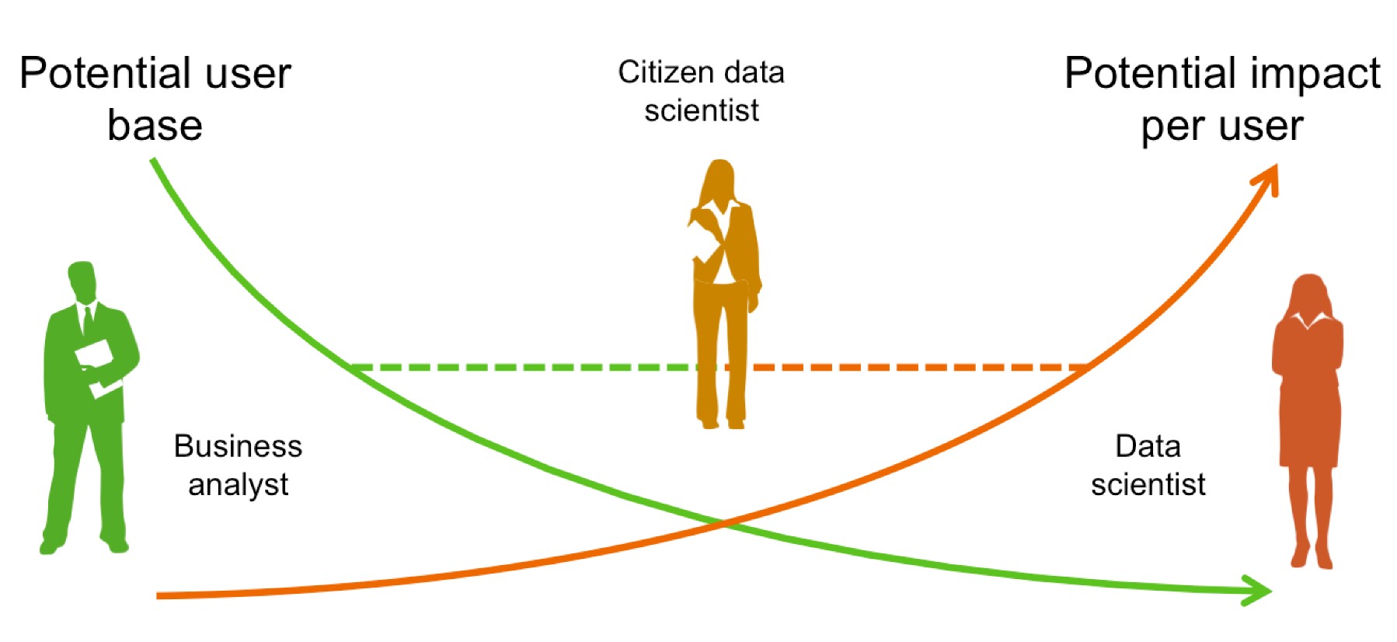
Model Builder – Who benefits the most
Notes:
Problem owners can drive the solution far better

Slide 16
Why own ML model matters?
Different businesses have different sense of data.
Specific problems relevant to individual business should be able to solve better by those business users.
Feedbacks of Movie, E-Commerce retail shopping website, Food ordering app may not be same type to categorize as good / bad.

Slide 17
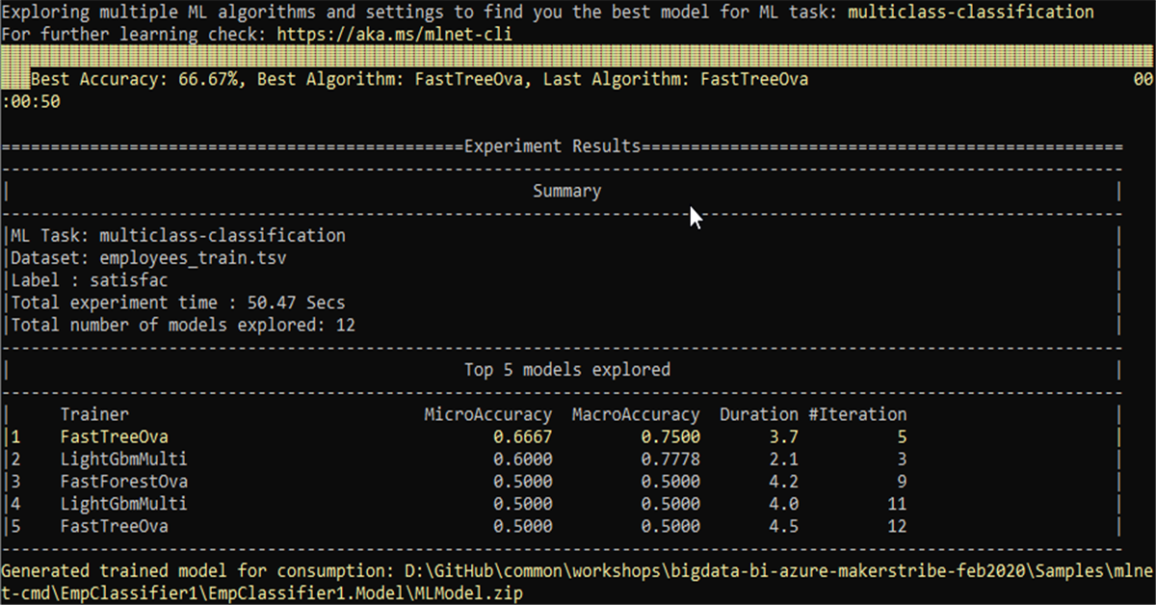
Best practices - Interpreting results
Notes:
Dataset of 200 items had 180 low-satisfaction items, 10 medium-satisfaction items and 10 high-satisfaction items. A model could just predict low-satisfaction for all items and score 180 / 200 = 0.9000 accuracy for the MicroAccuracy metric. But the MacroAccurcy would be (0.9000 + 0.0500 + 0.0500) / 3 = 0.3333.

Slide 18
Choosing ML products provided by Microsoft
ML.Net
Azure ML
If you are building a .NET app and want to integrate ML, use ML.NET.
You don't pay anything for using ML.NET itself. It is just a toolkit that you can run anywhere.
If you don't do .NET, use Azure ML.
If you are ready to pay for the cloud compute power that you "burn“, go-ahead using Azure ML.

Slide 19
Power BI
Business Intelligence tool.
Connect – Analyse – Visualize – Share
Best in UX – easy to use for a non-tech person as well.
Dashboards renderable in Mobile, TV, Large screen displays.
Formulas – reused ones from Excel itself.
Free with most featured for single user.

Slide 20
My Use Case for ML.Net Model Builder
Goal: Recognize the sentiment of feedback text with 3 rating.
Reason: 1,2 rating mostly will have worst comment. Similarly 4,5 will have good comments. Feedbacks with 3 rating is annoying and yet to predict.

Slide 21
1. Sentiment of existing feedbacks using Azure Cognitive
2. Dashboard for insights
3. Create own model by training with sentiment detected.
4. Pipeline to retrain the model

Slide 22
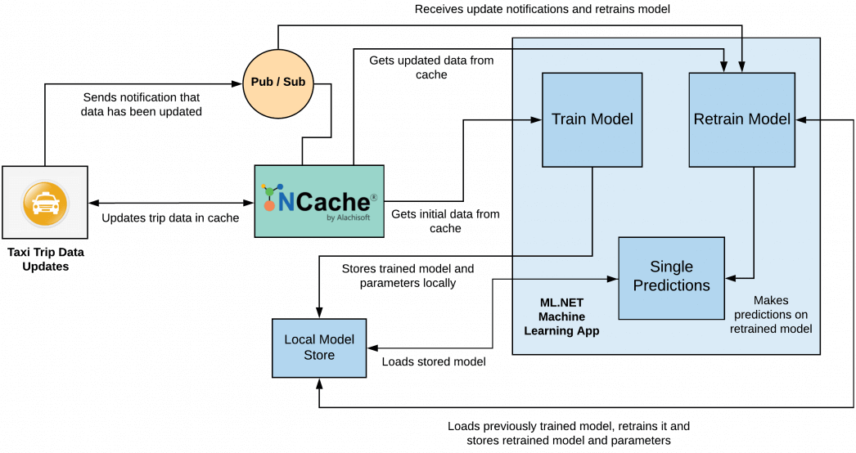

Slide 23
https://github.com/dinesarun/public/tree/master/public-workshops/azconf-mlnet-nov2020

